Slide 1
Football Insights: Building Analytics Solutions with Azure and OpenAI
Ashish Sharma, Microsoft Azure MVP

Slide 2

Who am I?
Introduction to myself!

Slide 3

Data is the fuel that powers AI
What is Data analysis?
Process of inspecting, cleaning, transforming, and modeling data with the goal of discovering useful information, informing conclusions, and supporting decision-making.
Notes:
Data analysis
Process of inspecting, cleaning, transforming, and modeling data with the goal of discovering useful information, informing conclusions, and supporting decision-making.
It involves various techniques, including statistical analysis, machine learning, and data visualization, to extract insights from raw data.

Slide 4
Steps in Data Analysis
Key Steps in
Data Analysis
Data Collection
Data Cleaning
Exploratory Data Analysis (EDA)
Data Modelling
Interpretation and Communication
Notes:
Key Steps in Data Analysis
Data Collection: Gathering relevant data from various sources, including databases, sensors, surveys, and digital platforms.
Data Cleaning: Preprocessing and cleansing the data to remove errors, duplicates, outliers, and inconsistencies.
Exploratory Data Analysis (EDA): Exploring the data through descriptive statistics, data visualization, and summary metrics to gain initial insights.
Data Modeling: Applying statistical techniques, machine learning algorithms, or predictive models to analyze the data and derive meaningful conclusions.
Interpretation and Communication: Interpreting the results of the analysis and communicating insights effectively to stakeholders through reports, dashboards, or presentations.

Slide 5
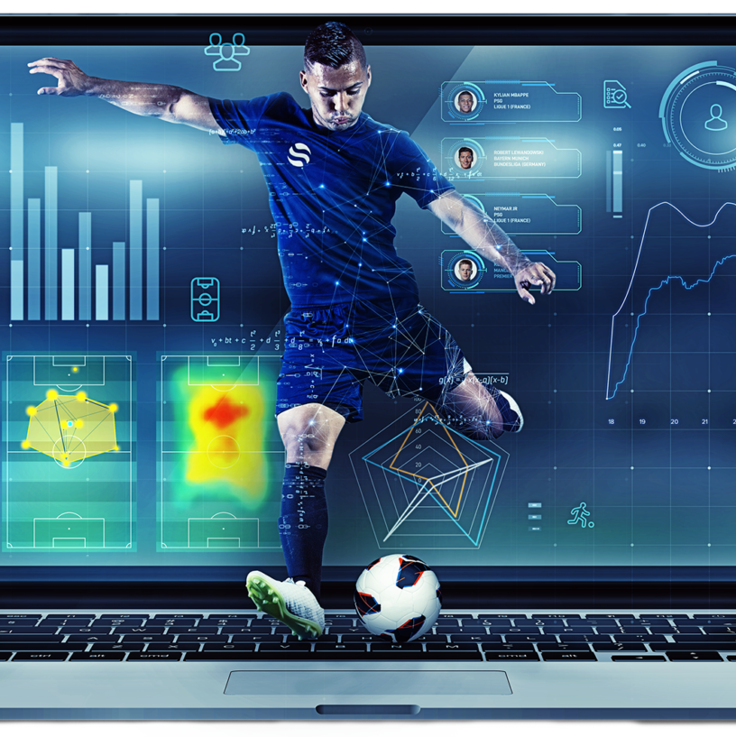
Introduction to Football Analytics:
Football analytics refers to the use of data analysis techniques to gain insights into various aspects of the sport, including player performance, team strategies, and talent scouting

Slide 6
Azure AI Studio (2)
Importance of Football Analytics
The importance of football analysis lies in its ability to provide teams with valuable insights and strategic advantages in a highly competitive sport.
Player Performance
Passing accuracy
Shot accuracy
Defensive actions
Physical Metrics
Strategic Decision-Making
Possession statistics
Passing patterns
Formation effectiveness
Tactical trends
Talent Identification and Recruitment
Data-driven scouting techniques
Gain a competitive advantage in the transfer market
Injury Prevention
Analyzing player workload, injury history, and physical performance metrics
Tailored training programs and rotation strategies
Revenue Generation
Fan Engagement
Ticket sales, merchandise purchases, sponsorships, and broadcasting rights deals.
Notes:
Optimizing Performance: Football analysis enables teams to evaluate player performance in granular detail. By analyzing statistics such as passing accuracy, shot accuracy, defensive actions, and physical metrics, coaches can identify areas for improvement and tailor training regimes to enhance individual player performance.
Strategic Decision-Making: Analysis of team-level data, including possession statistics, passing patterns, formation effectiveness, and tactical trends, allows coaches to develop game plans that capitalize on their strengths while exploiting opponents' weaknesses. This strategic approach can significantly influence match outcomes by maximizing scoring opportunities and minimizing defensive vulnerabilities.
Talent Identification and Recruitment: Football analysis plays a crucial role in talent identification and recruitment processes. By utilizing data-driven scouting techniques, clubs can identify promising players who possess the specific skills and attributes needed to complement their team's style of play. Advanced scouting analytics can also help clubs unearth undervalued talent and gain a competitive advantage in the transfer market.
Injury Prevention and Management: Analyzing player workload, injury history, and physical performance metrics can aid in injury prevention and management. By monitoring players' physical condition through data analysis, clubs can implement tailored training programs and rotation strategies to minimize the risk of injuries and optimize player availability over the course of a season.
Fan Engagement and Performance Analysis: Football analysis isn't limited to teams and coaching staff; it also enhances the experience for fans and analysts alike. Advanced statistics, visualizations, and insights generated through data analysis contribute to a deeper understanding of the game, sparking discussions and debates among fans and analysts. Additionally, performance analysis tools and platforms provide fans with access to real-time match data, player statistics, and tactical breakdowns, enriching their engagement with the sport.
Revenue Generation: Football analysis can also have financial implications for clubs through revenue generation opportunities. Enhanced on-field performance resulting from data-driven decision-making can lead to increased ticket sales, merchandise purchases, sponsorships, and broadcasting rights deals. Additionally, clubs can monetize their data and analysis capabilities by offering consulting services, licensing proprietary analytics software, or participating in data-driven partnerships with external organizations.

Slide 7
Steps in Football Data Analysis
Key Steps in
Football
Data Analysis
Data Collection
Data Cleaning
Exploratory Data Analysis (EDA)
Data Modelling
Interpretation and Communication
Notes:
Key Steps in Data Analysis
Data Collection: Gathering relevant data from various sources, including databases, sensors, surveys, and digital platforms.
Data Cleaning: Preprocessing and cleansing the data to remove errors, duplicates, outliers, and inconsistencies.
Exploratory Data Analysis (EDA): Exploring the data through descriptive statistics, data visualization, and summary metrics to gain initial insights.
Data Modeling: Applying statistical techniques, machine learning algorithms, or predictive models to analyze the data and derive meaningful conclusions.
Interpretation and Communication: Interpreting the results of the analysis and communicating insights effectively to stakeholders through reports, dashboards, or presentations.

Slide 8

Football analytics architecture on Azure
Notes:
Sports analytics is a field that applies data analytics techniques to team or individual performance data. Then you can use the data to create a competitive advantage over an opponent. In addition to analyzing traditional box score statistics, there has been an explosion of data in recent years that sports teams can use to improve the performance of an individual athlete or an entire team. Examples of such data include player data collected from sensors and spatial data that captures player movement during a game. Traditional systems struggle to process and maintain these data sources because of the large volumes of data generated. These data sources also format data in several different ways and allow users to process data at different speeds, providing more challenges for traditional data processing solutions.
Potential use cases
This solution is ideal for the sports industry, and applies to the following scenarios:
Manage large volumes of data from several source systems in a centralized ecosystem.
Analyze player tracking and temporal data to gain insights into individual and team performance.
With consideration for spatial metrics, determine the best possible player positioning and strategies during gameplay.
Process and evaluate player performance data to optimize athlete training routines.
Analyze historical data to make well-informed personnel decisions during the draft or free agency.
Store and analyze real-time telemetry from Internet of Things (IoT) devices that are attached to equipment like bats, shoulder pads, and volleyballs.

Slide 9






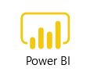

Football analytics architecture on Azure
Notes:
Components
Azure Data Lake Storage is a scalable and secure data lake for high-performance analytics workloads. You can use Data Lake Storage to manage petabytes of data with high throughput. It can accommodate multiple, heterogeneous sources and data that's in structured, semi-structured, or unstructured formats.
Azure Databricks is a data analytics platform that uses Spark clusters. The clusters are optimized for the Azure platform.
Azure Data Factory is a fully managed, scalable, and serverless data integration service. It provides a data integration and transformation layer that works with various data stores.
Azure Machine Learning is a cloud service for accelerating and managing the machine learning project lifecycle. Machine learning professionals, data scientists, and engineers can use it in their day-to-day workflows to train, deploy models, and manage MLOps. You can create a model in Machine Learning or use a model built from an open-source platform like PyTorch, TensorFlow, or scikit-learn. MLOps tools help you monitor, retrain, and redeploy models.
Azure Event Hubs is a big-data streaming platform and event ingestion service. It can receive and process millions of events per second. Data sent to an event hub can be transformed and stored by using any real-time analytics provider or batching/storage adapters.
Azure SQL Database is a fully managed platform as a service (PaaS) database engine that handles most of the database management functions like upgrading, patching, backups, and monitoring without user involvement. SQL Database is always running on the latest stable version of the SQL Server database engine and patched OS with high availability.
Power BI is a collection of software services, apps, and connectors that work together to turn your unrelated sources of data into coherent, visually immersive, and interactive insights.
Power Apps is a suite of apps, services, connectors, and data platform that provides a rapid development environment to build custom apps for your business needs. By using Power Apps, you can quickly build custom business apps that connect to your data stored either in the underlying data platform or in various online and on-premises data sources like SharePoint, Microsoft 365, and Dynamics 365.
Azure App Service is an HTTP-based service for hosting web applications, REST APIs, and mobile back ends. You can use it with your favorite languages, like .NET, .NET Core, and Java.
Microsoft Defender for Cloud is a tool for security posture management and threat protection.
Azure Cost Management and Billing helps you understand your Azure invoice, manage your billing account and subscriptions, monitor, control Azure spending, and optimize resource use.
Azure Monitor delivers a comprehensive solution for collecting, analyzing, and acting on telemetry from your cloud and on-premises environments.
Azure Key Vault is a cloud service for securely storing and accessing secrets.
Microsoft Entra ID is an identity service that provides single sign-on, multifactor authentication, and conditional access to guard against most cybersecurity attacks.
Azure DevOps provides developer services so that teams can plan work, collaborate on code development, and build and deploy applications. Azure DevOps supports a collaborative culture and set of processes that bring together developers, project managers, and contributors to develop software.

Slide 10
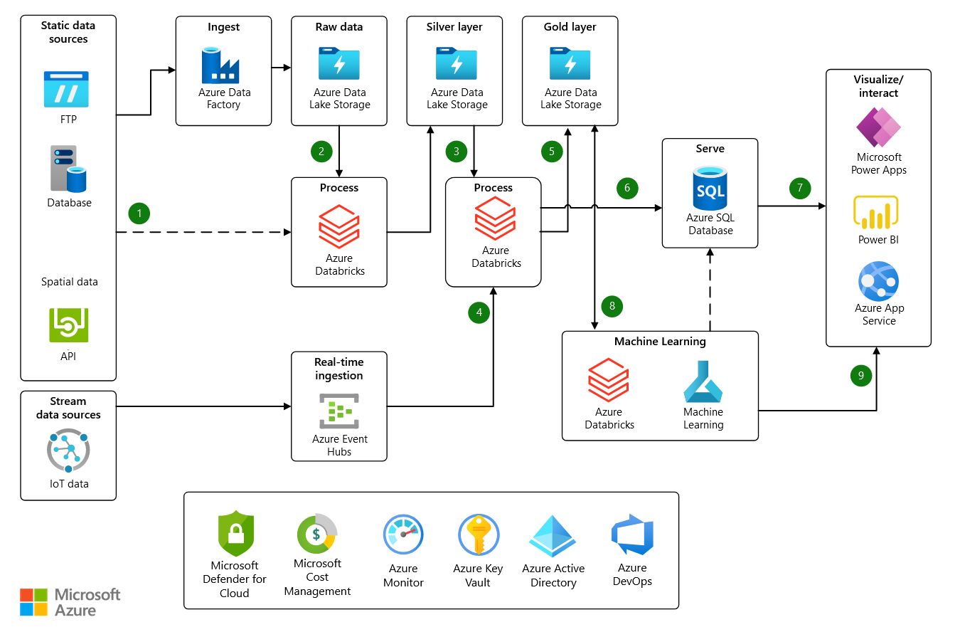
Notes:
Dataflow
Data is ingested from source systems by using one of the following methods:
Azure Data Factory ingests raw data from several data sources and stores it in Azure Data Lake Storage for downstream processing.
Some raw data sources might be large and might not need the raw data to be stored in Data Lake Storage initially, like the spatial on-court/on-field data. In these cases, you can use Azure Databricks to ingest source data and immediately transform data so that it's cleansed, normalized, and saved to Data Lake Storage in an easy-to-digest format.
Data that's generated by sensors in real-time is ingested as messages by Azure Event Hubs.
Azure Databricks transforms raw data so that it's cleansed of any errors and normalized. With the cloudFiles feature of Azure Databricks Auto Loader, raw files are automatically processed as they land in Data Lake Storage. The transformed data moves back into Data Lake Storage for further curating.
Azure Databricks applies business logic to the transformed data. Stream data is also combined with the transformed data during this process.
Azure Databricks processes stream data from Azure Event Hubs and combines it with static data.
The final processed data is written to Data Lake Storage in Delta format.
Transformed data that's used in the visualization layer, like Power BI, is written to an Azure SQL Database. This database becomes the data source for any reporting needs.
Curated data is visualized and manipulated through Power BI, Power Apps, or a custom web application that's hosted by an Azure App Service.
Azure Machine Learning builds and trains machine learning models by using data imported into Azure Machine Learning Datasets and external sources. The datasets and sources are directly linked to the Azure Machine Learning Workspace. You can control access and authentication for data and the Machine Learning workspace with Microsoft Entra ID and Azure Key Vault. Models can also be retrained as necessary in Machine Learning.
As an alternative to storing model results in Data Lake Storage or SQL Database, you can deploy Machine Learning models to containers using Azure Kubernetes Services (AKS) as a web service and called via a REST API endpoint. The web service deploys by using an Azure App Service, and then you can send data to the REST API endpoint and receive the prediction returned by the model within the web application.
Throughout the process:
Azure Monitor collects information on events and performance.
Key Vault secures passwords, connection strings, and secrets.
Azure DevOps manages code repositories and deployment pipelines.

Slide 11

Football Insights using Gen AI solution
Azure Open AI
Notes:
"Gen AI," short for "Generative AI," refers to a type of artificial intelligence that can generate new content, such as images, text, or even music, based on patterns and examples it has learned from. It works by analyzing large datasets to understand the underlying structures and then using that knowledge to create new, original content that resembles the patterns it has learned. In simple terms, it's like having a creative assistant that can come up with new ideas or create new things by learning from existing examples.
Implementing Generative AI (Gen AI) with football data involves using machine learning algorithms to analyze vast amounts of football-related information, such as player statistics, match results, and gameplay footage. Here's a simplified explanation of how it could work:
Data Collection: Gather a comprehensive dataset containing various types of football data, including player performance statistics, match outcomes, team strategies, and more.
Preprocessing: Clean and organize the data to ensure consistency and remove any irrelevant or redundant information. This step may involve tasks like data normalization, feature extraction, and handling missing values.
Training the Model: Use machine learning techniques, such as deep learning algorithms, to train a Generative AI model on the prepared dataset. The model learns the underlying patterns and relationships within the data to generate meaningful outputs.
Generating Insights: Once the model is trained, it can be used to generate insights and predictions related to football. For example, it could predict player performance in future matches, suggest optimal team formations based on player attributes, or even create hypothetical scenarios for tactical analysis.
Validation and Refinement: Validate the generated insights against real-world data to assess their accuracy and effectiveness. Continuously refine the model based on feedback and new data to improve its performance over time.
Deployment: Deploy the trained Generative AI model in practical applications, such as sports analytics platforms or coaching tools, to assist football teams, coaches, and analysts in making informed decisions and gaining deeper insights into the game.
Overall, implementing Generative AI in football data analysis involves leveraging advanced machine learning techniques to extract valuable insights and enhance decision-making processes within the realm of football.

Slide 12
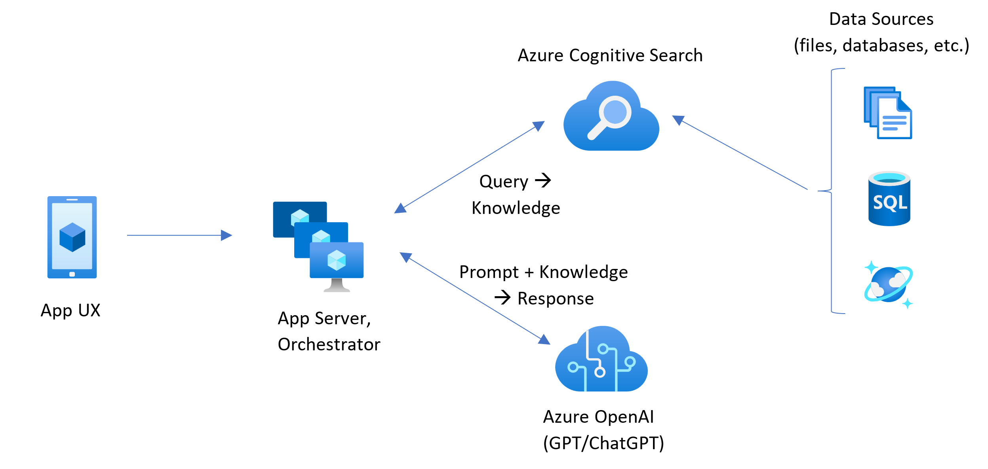
Football Insights using Azure Open AI
Notes:
Implementing football insights using Azure and OpenAI involves leveraging Azure's cloud computing services along with OpenAI's powerful language models to analyze football data and generate valuable insights. Here's a simplified explanation of how this could work:
Data Collection and Storage: Utilize Azure's data services, such as Azure Blob Storage or Azure SQL Database, to collect and store football-related data. This data could include player statistics, match results, team formations, and other relevant information sourced from various data providers or APIs.
Data Processing and Analysis: Use Azure's data processing services, such as Azure Databricks or Azure Synapse Analytics, to preprocess and analyze the collected football data. This involves cleaning the data, performing statistical analysis, and identifying patterns or trends using machine learning algorithms.
Integration with OpenAI: Incorporate OpenAI's language models, such as GPT (Generative Pre-trained Transformer), into the Azure environment. OpenAI's models are capable of understanding and generating human-like text based on the provided input.
Generating Football Insights: Utilize the processed football data as input to the OpenAI model to generate insightful analyses, predictions, or summaries. For example, you could prompt the model with questions like "What are the key factors influencing match outcomes?" or "Predict the top goal scorers for the upcoming season." The model will then generate text-based responses based on its understanding of the data.

Slide 13
Latest Azure OpenAI Service models
Announcing
Preview
GPT-4 Turbo
Preview
GPT-4 Turbo with Vision
Preview
DALL·E-3
Preview
Assistants API
Preview
Fine-tuning for GPT-4

Slide 14
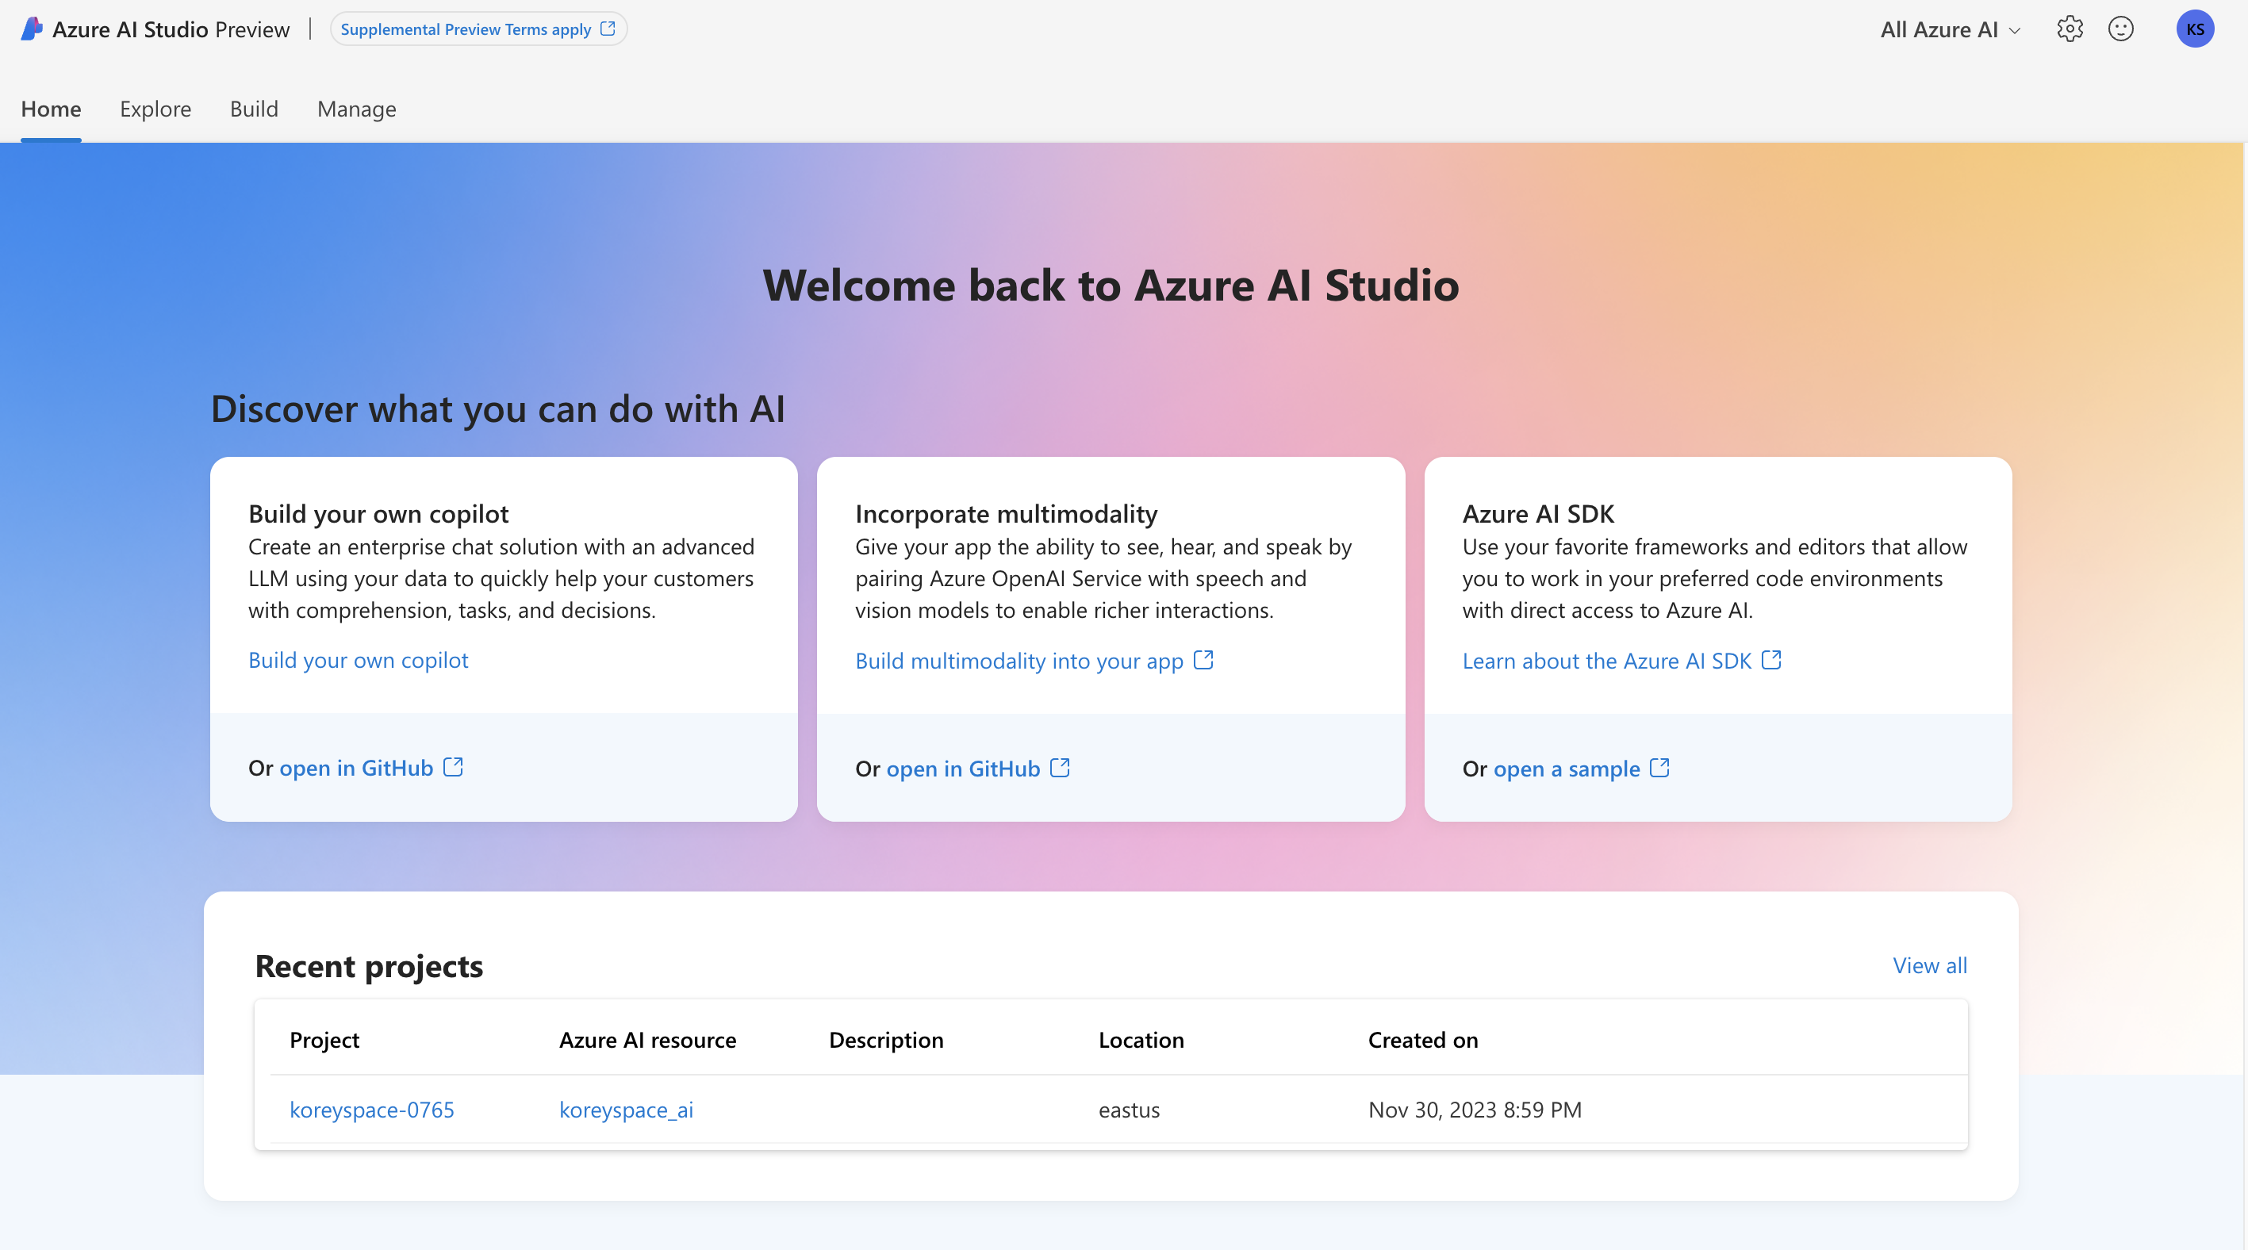
Exploring the Models
Azure AI Studio - https://ai.azure.com

Slide 15
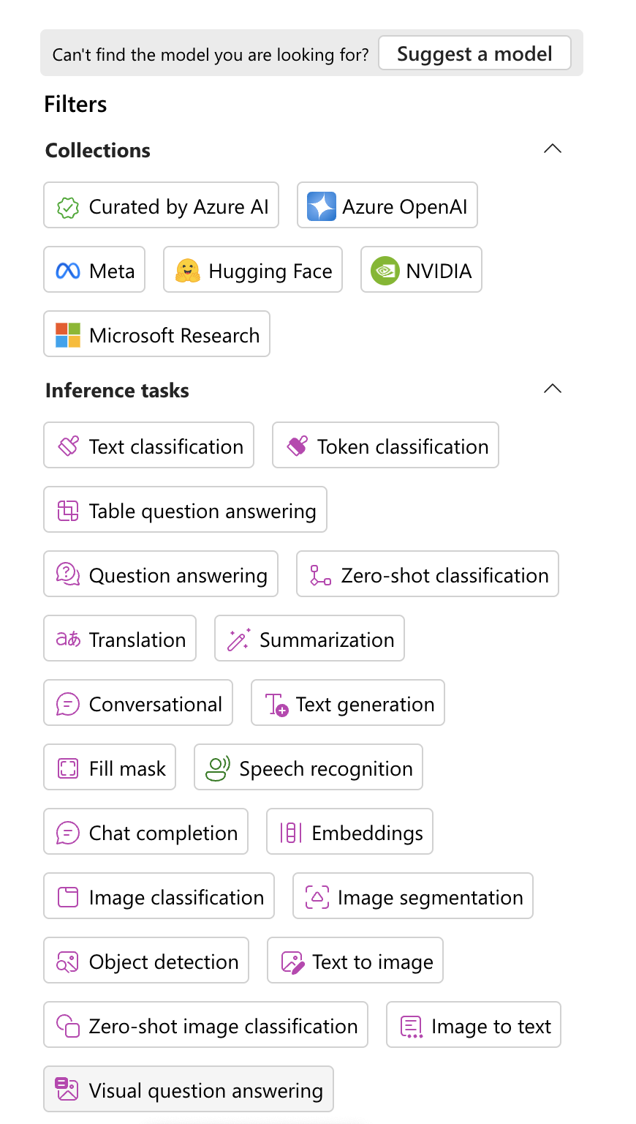
Exploring the Models
Azure AI Studio

Slide 16
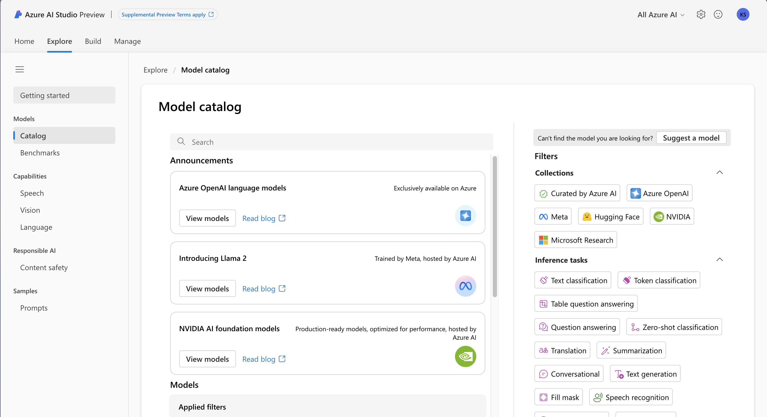
Exploring the Models
Azure AI Studio

Slide 17
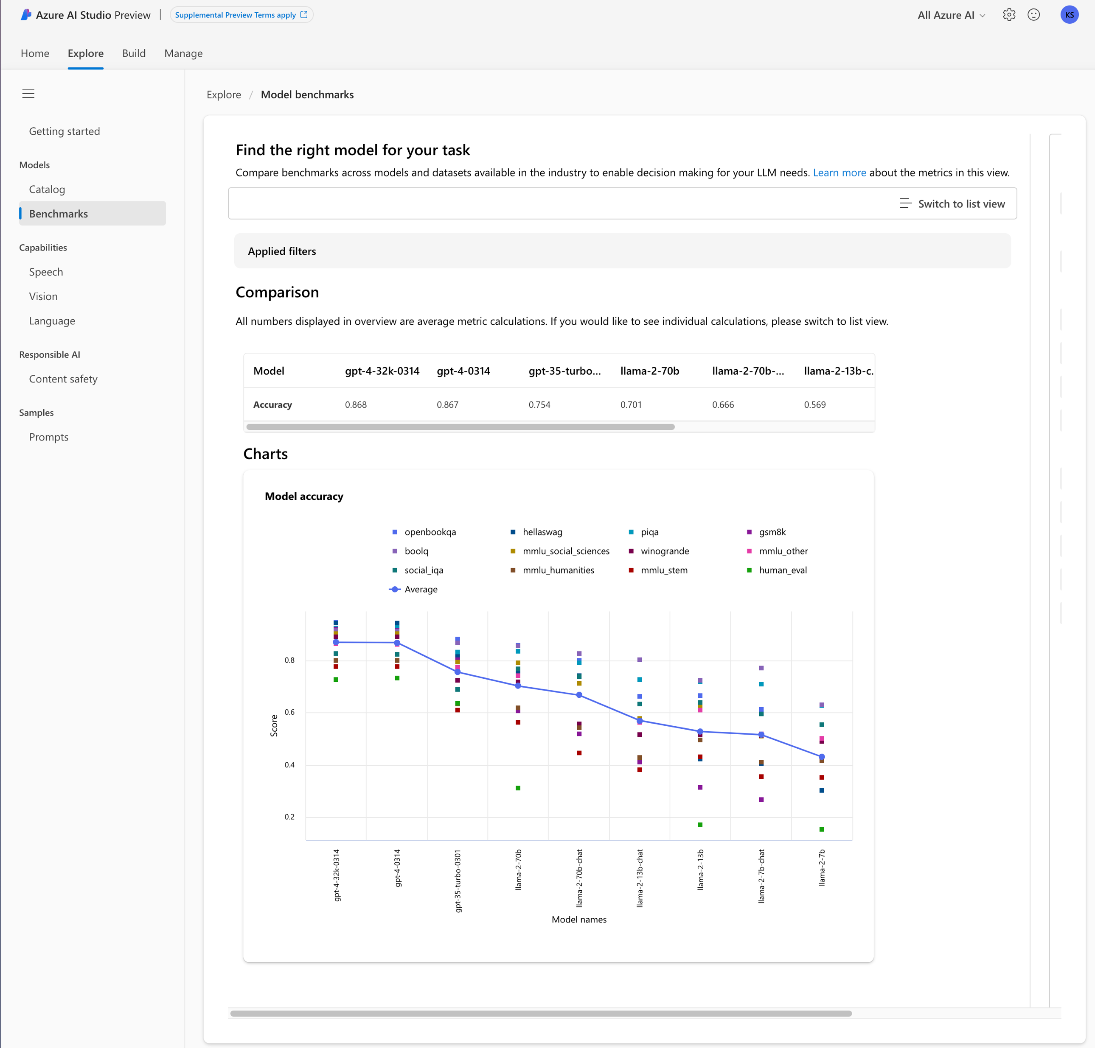
Comparing Models
Azure AI Studio

Slide 18
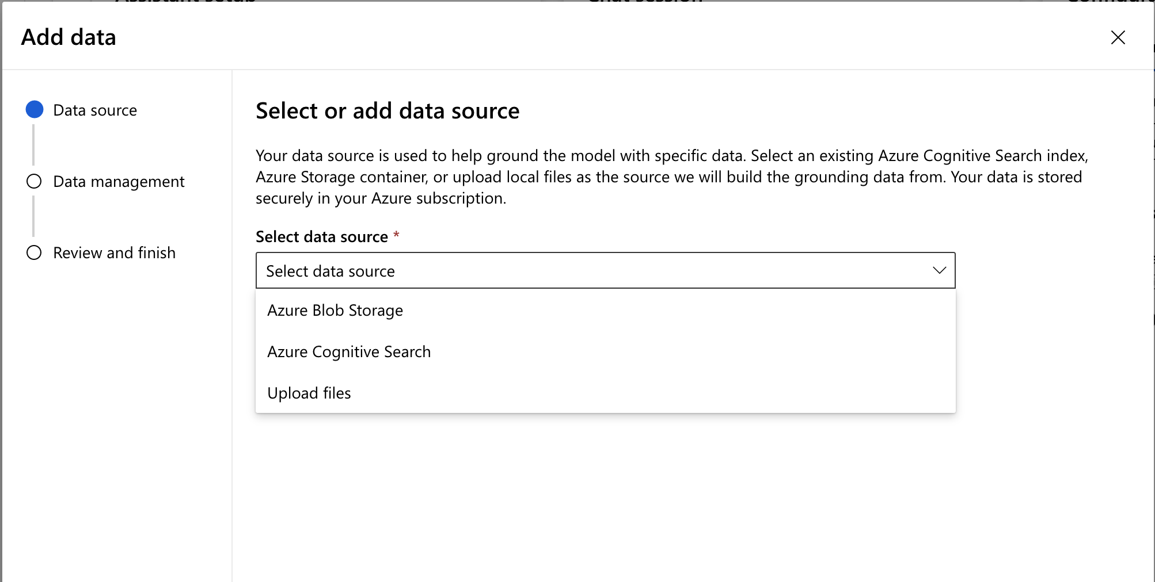
Adding a Data Source
Chat With Your Data

Slide 19
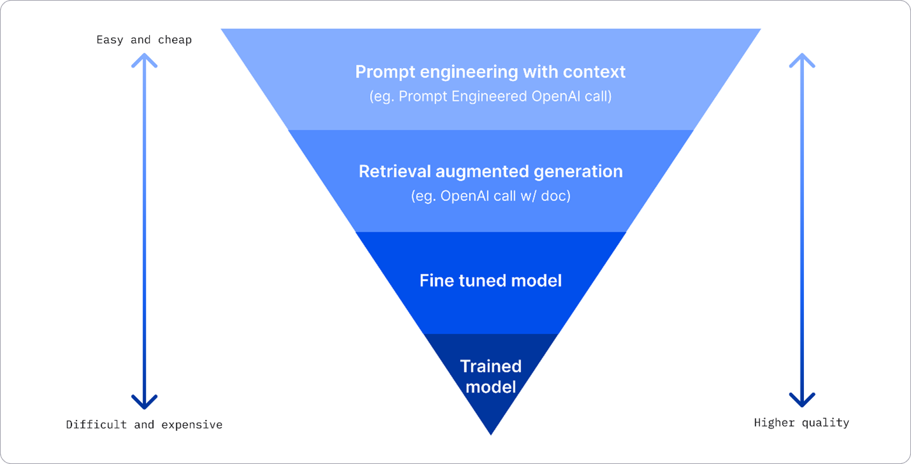
Improving Results

Slide 20
Use Cases

Slide 21
Player Performance Analysis
Use Case 1
Generate detailed player profiles, performance evaluations, and comparisons. Provide insights into areas for improvement, potential playing positions, and tactical suitability.
Notes:
Business Problem: Football clubs and coaches need insights into individual player performance to optimize team selection, tactics, and training regimes.
Business Needs: Detailed analysis of player statistics, strengths, weaknesses, and potential contributions to the team.
Solution: Utilize Generative AI to analyze large volumes of player data, including match statistics, physical attributes, and playing style. OpenAI models can generate comprehensive player profiles and performance insights based on the input data.
What Gen AI Can Do: Generate detailed player profiles, performance evaluations, and comparisons. Provide insights into areas for improvement, potential playing positions, and tactical suitability.

Slide 22
Tactical Analysis and Strategy Planning
Use Case 2
Analyze opponent teams' formations, pressing patterns, transition play, and set-piece strategies. Generate insights into potential vulnerabilities and areas to exploit during matches.
Notes:
Business Problem: Football coaches and analysts require insights into opposing teams' tactics, strengths, weaknesses, and potential strategies to formulate effective game plans.
Business Needs: In-depth analysis of opponent teams' playing styles, formations, key players, and tactical nuances.
Solution: Leverage Generative AI to analyze opponent teams' historical match data, formations, and playing styles. OpenAI models can generate tactical analyses, scouting reports, and strategic recommendations based on the input data.
What Gen AI Can Do: Analyze opponent teams' formations, pressing patterns, transition play, and set-piece strategies. Generate insights into potential vulnerabilities and areas to exploit during matches.

Slide 23
Transfer Market Analysis
Use Case 3
Provide assessments of player market value, potential transfer destinations, and optimal transfer strategies for clubs and agents.
Notes:
Business Problem: Football clubs and agents need insights into player valuations, market trends, and potential transfer targets to make informed decisions in the transfer market.
Business Needs: Accurate assessments of player value, market demand, and potential transfer fees.
Solution: Utilize Generative AI to analyze player performance data, contract details, market trends, and club finances. OpenAI models can generate insights into player valuations, transfer probabilities, and suitable destinations based on the input data.
What Gen AI Can Do: Provide assessments of player market value, potential transfer destinations, and optimal transfer strategies for clubs and agents.

Slide 24
Injury Risk Assessment
Use Case 4
Predict injury risks for individual players, identify factors contributing to injury susceptibility, and recommend interventions to mitigate risks.
Notes:
Business Problem: Football clubs aim to minimize player injuries and optimize squad fitness to maintain performance levels throughout the season.
Business Needs: Early identification of injury risks, preventive measures, and tailored training programs for individual players.
Solution: Leverage Generative AI to analyze player health data, injury histories, training loads, and match participation. OpenAI models can generate injury risk assessments, personalized training recommendations, and injury prevention strategies based on the input data.
What Gen AI Can Do: Predict injury risks for individual players, identify factors contributing to injury susceptibility, and recommend interventions to mitigate risks.

Slide 25
Fan Engagement & Content Generation
Use Case 5
Personalize content based on fan demographics, preferences, and interaction history.

Slide 26
Youth Player Development
Use Case 6
Evaluate youth players' technical skills, tactical understanding, physical attributes, and mental attributes. Provide recommendations for training programs, positional development, and career pathways.
Notes:
Business Problem: Football academies and youth development programs aim to identify and nurture talented young players for future success in professional football.
Business Needs: Comprehensive assessments of youth players' potential, strengths, weaknesses, and developmental needs.
Solution: Utilize Generative AI to analyze youth player performance data, physical attributes, and potential indicators of future success. OpenAI models can generate talent assessments, development plans, and scouting reports for youth players based on the input data.
What Gen AI Can Do: Evaluate youth players' technical skills, tactical understanding, physical attributes, and mental attributes. Provide recommendations for training programs, positional development, and career pathways.

Slide 27
Demo
Notes:
https://community.fabric.microsoft.com/t5/Data-Stories-Gallery/Football-Player-Analysis-21-22/m-p/3706185

Slide 28
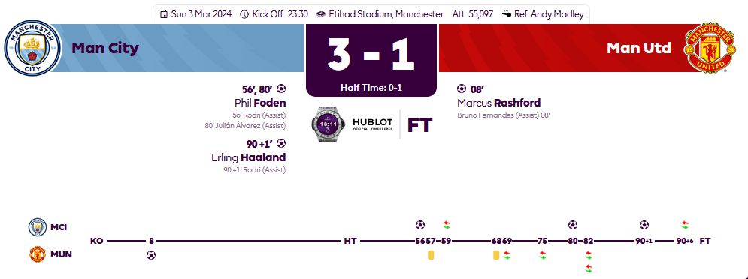
Notes:
https://community.fabric.microsoft.com/t5/Data-Stories-Gallery/Football-Player-Analysis-21-22/m-p/3706185

Slide 29
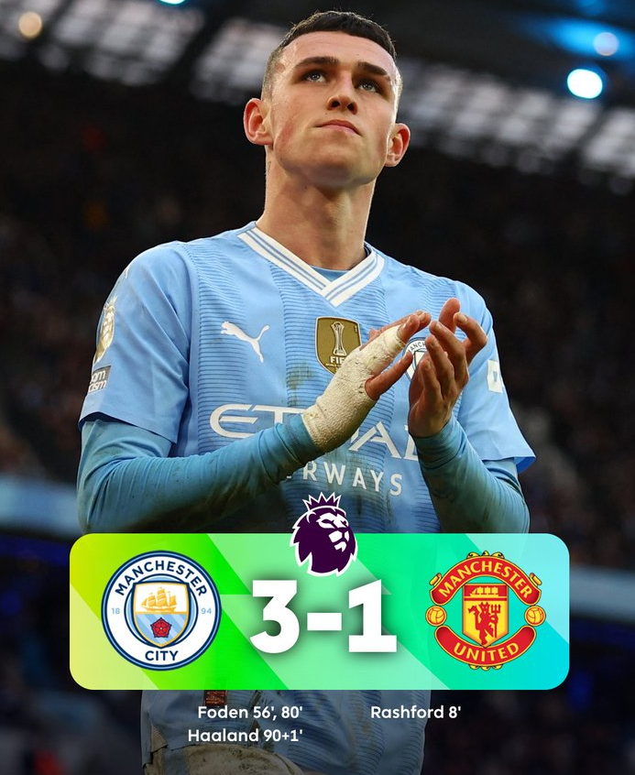
Notes:
https://community.fabric.microsoft.com/t5/Data-Stories-Gallery/Football-Player-Analysis-21-22/m-p/3706185

Slide 30
Thank you

